Slide 1
Continuous random variables
Expected value of the continuous random variables

Slide 2
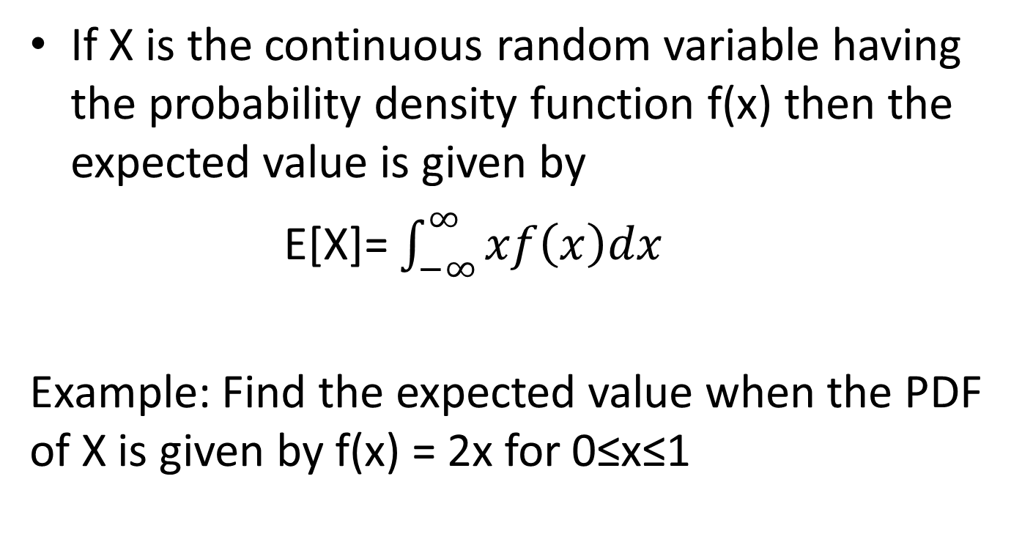
Expected value
If X is the continuous random variable having the probability density function f(x) then the expected value is given by
E[X]= $\int_{−∞}^{∞}{xf\left(x\right)dx}$
Example: Find the expected value when the PDF of X is given by f(x) = 2x for 0≤x≤1

Slide 3
Similarly we have expected value for any function of random variable
E[2X]=
E[X^2]=
E[2X-1]=
E[(X-5)^2]=

Slide 4
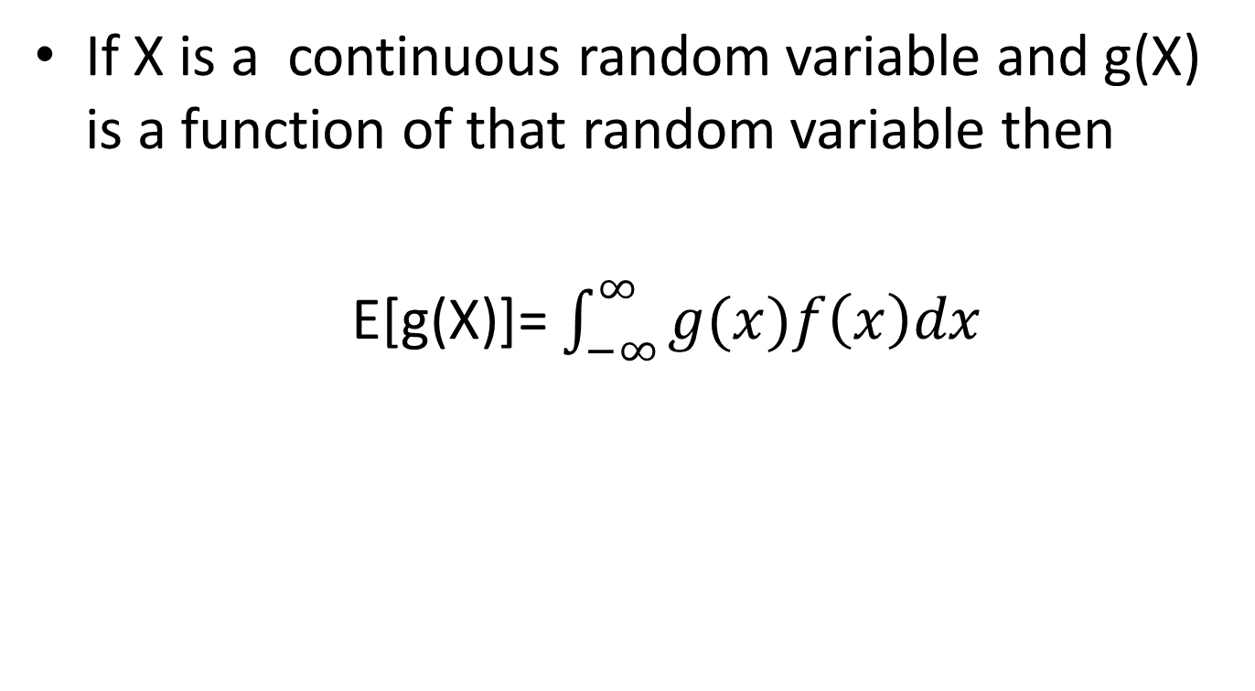
IMPORTANT RESULT
If X is a continuous random variable and g(X) is a function of that random variable then
E[g(X)]= $\int_{−∞}^{∞}{g(x)f\left(x\right)dx}$

Slide 5
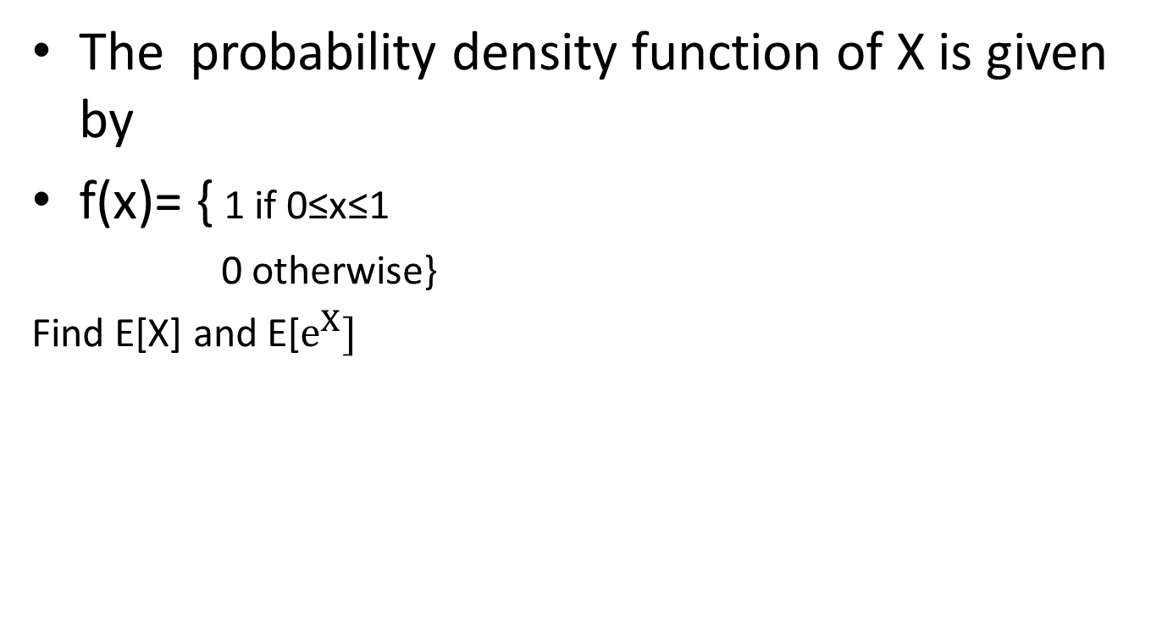
Example
The probability density function of X is given by
f(x)= { 1 if 0≤x≤1
0 otherwise}
Find E[X] and E[$e^{X}]$

Slide 6
Linearity of expected value of X
E[aX+b]=aE[X]+b
Important Note:
E[b]=?

Slide 7
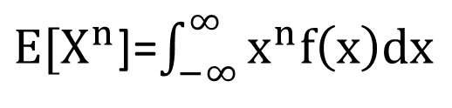
MOMENT
E[X] is called the first moment of X
E[X^{n}] is called the n^{th} moment of X
${E[X}^{n}$]=$\int_{−∞}^{∞}{x^{n}f\left(x\right)dx}$

Slide 8
Variance of the Continuous Random Variable X

Slide 9
Variance of the random variable X
A measure how much spread is the random variable
If X is a random variable with
mean µ ( Expected value),then the variance of
X, denoted by Var(X) is defined by
Alternate formula : Var(X)= E[X^2]-(E[x])^2

Slide 10
Linearity of Variance of X
Var(aX+b)=?
Does Linearity hold here?
Var[b]=?
Var[X+b]=?

Slide 11
Example
Calculate Var(X) if X when the PDF of X is given by f(x) = 2x for 0≤x≤1

Slide 12
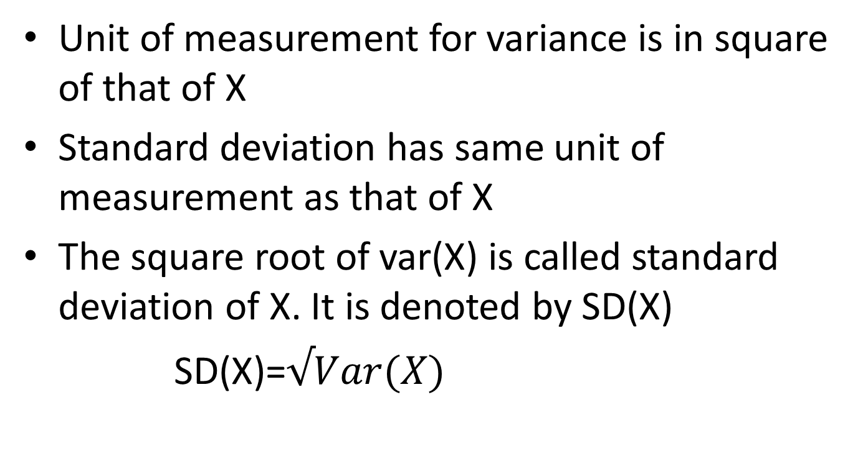
Standard deviation of X
Unit of measurement for variance is in square of that of X
Standard deviation has same unit of measurement as that of X
The square root of var(X) is called standard deviation of X. It is denoted by SD(X)
SD(X)=$√Var(X)$

Slide 13
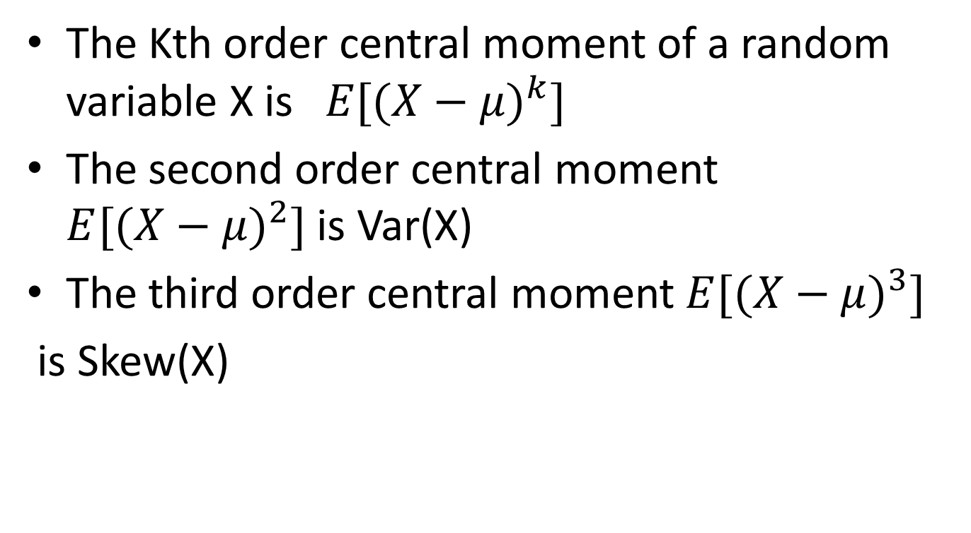
Central Moment( Moments about mean)
The Kth order central moment of a random variable X is$E[({X−μ)}^{k}]$
The second order central moment $E[({X−μ)}^{2}]$ is Var(X)
The third order central moment $E[({X−μ)}^{3}]$
is Skew(X)

Slide 14
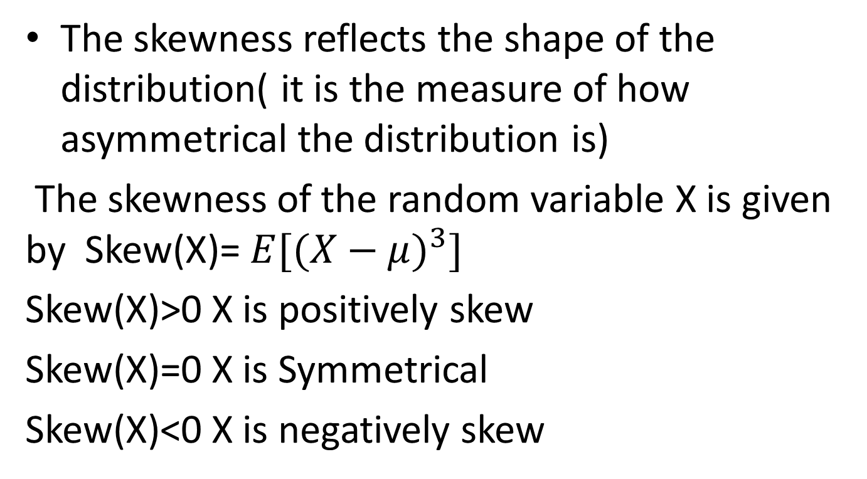
Skewness of random variable X
The skewness reflects the shape of the distribution( it is the measure of how asymmetrical the distribution is)
The skewness of the random variable X is given by Skew(X)= $E[({X−μ)}^{3}]$
Skew(X)>0 X is positively skew
Skew(X)=0 X is Symmetrical
Skew(X)<0 X is negatively skew

Slide 15
Important Continuous Distributions
Uniform Distribution
Exponential Distribution
Normal Distribution

Slide 16
Continuous Uniform Random variable
A random variable is said to be uniformly distributed over the interval (0,1) if its PDF is given by
f(x)={ 1 0<x<1
0 otherwise}
P(a≤x≤b)=?

Slide 17
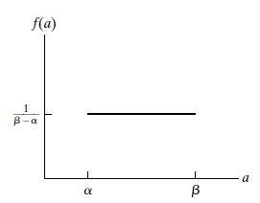
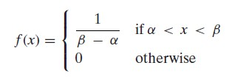
Continuous uniform random variable
If X is the uniform random variable on the interval
(α,β) if the PDF of X is given by

Slide 18
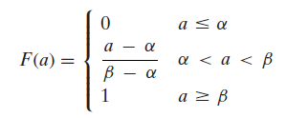
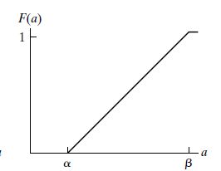
Cumulative Distribution Function(CDF) of the uniform random variable
The CDF of the uniform random variable on the interval (α,β) is given by

Slide 19
Expected value and the variance of the uniform random variable
If X is the uniform random variable on the interval (α,β)
E[X]=?
Var[X]=?

Slide 20
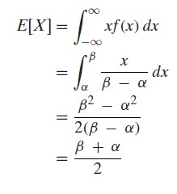
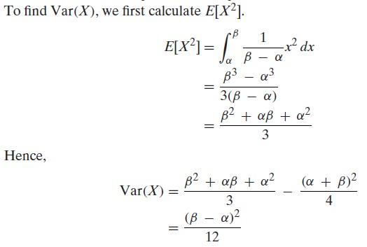

Slide 21
Examples
If X is uniformly distributed over (0,10).Find PDF and CDF and Calculate the probability that
(a) X<3 (b) X>6 (c) 3<X<8 (d) X=10

Slide 22
Exponential random variable
Exponential random variable is the continuous random variable. They often arise as the distribution of the amount of time until some specific event occurs.
EX: amount of time(starting from now) untill an earthquake occurs, untill a new war breaks out,untill a telephone call you receive turns out to be wrong call.
They can also be used to model the lifetimes

Slide 23
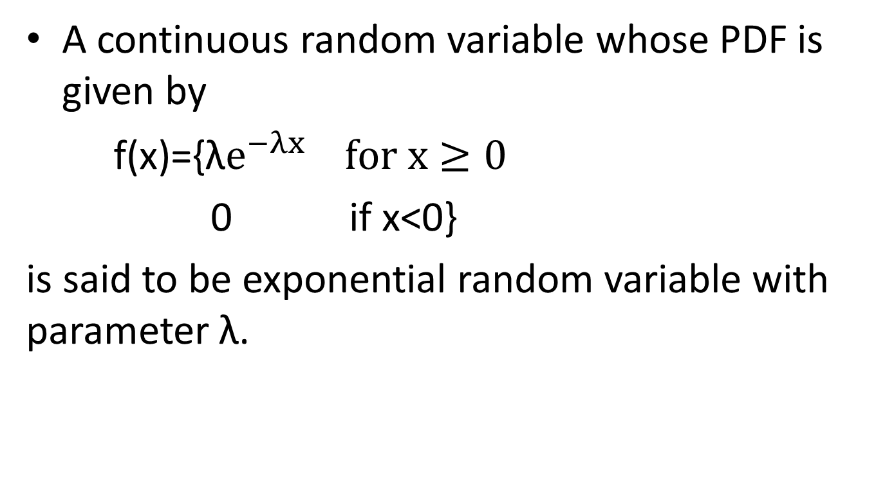
PDF of exponential random variable
A continuous random variable whose PDF is given by
f(x)={λ$e^{−λx} for x≥0$
0 if x<0}
is said to be exponential random variable with parameter λ.

Slide 24
CDF, E[X],Var[X] of exponential random variable
CDF=?
E[X]=?
Var[X]=?

Slide 25
Example
Suppose that the length of a phone call in minutes is an exponential random variable with parameter λ=1/10.If someone arrives immediately ahead of you at a public telephone booth. Find the probability that you will have to wait
More than 10 minutes
between 10 and 20 minutes

Slide 26
Normal Distribution
This is a continuous distribution that occurs naturally, for example the weights of babies at birth, the time taken to get to work everyday,
height, weight of students in a class
These variables all follow the same pattern

Slide 27
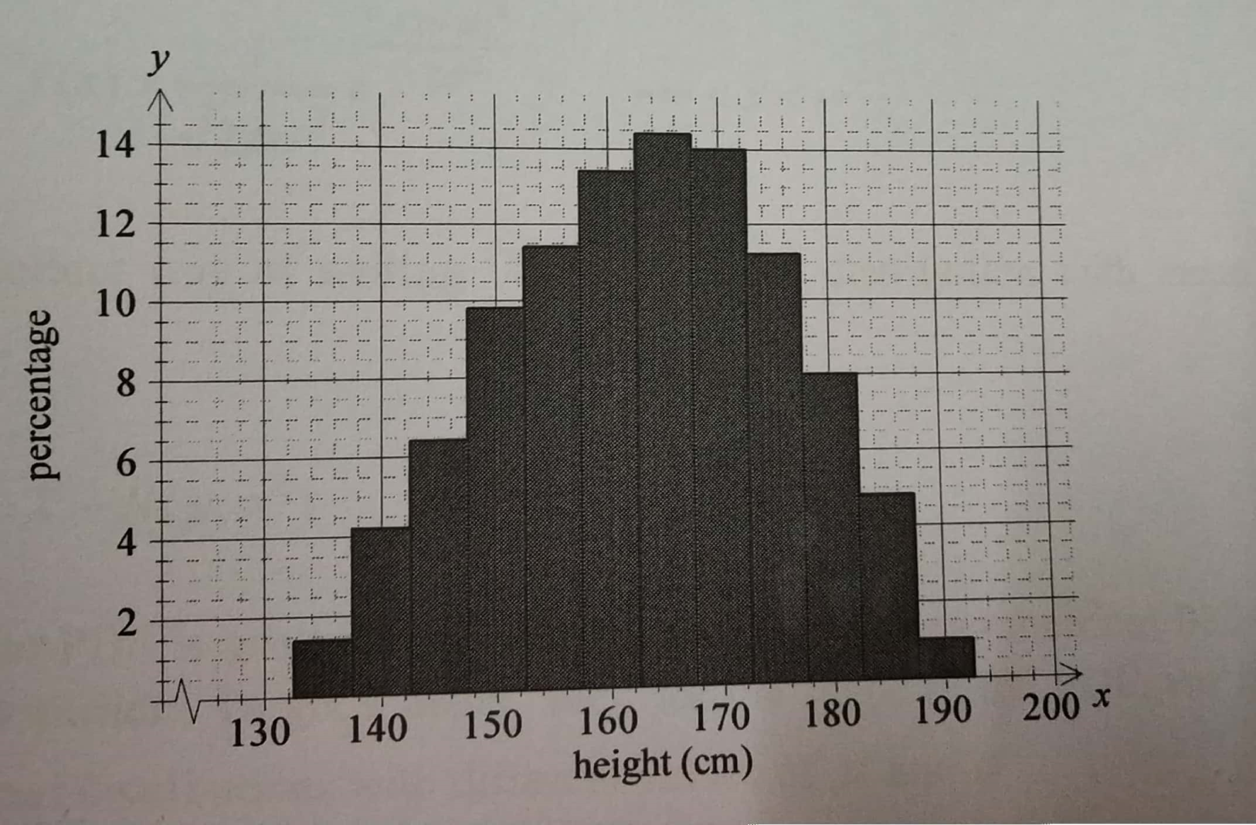
Histogram of the heights of all students at IIITS

Slide 28
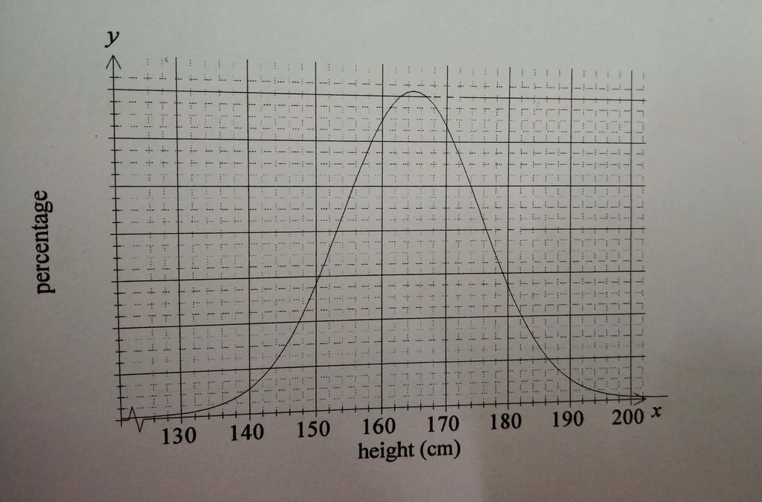
For larger and larger sample with smaller classes

Slide 29
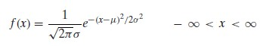
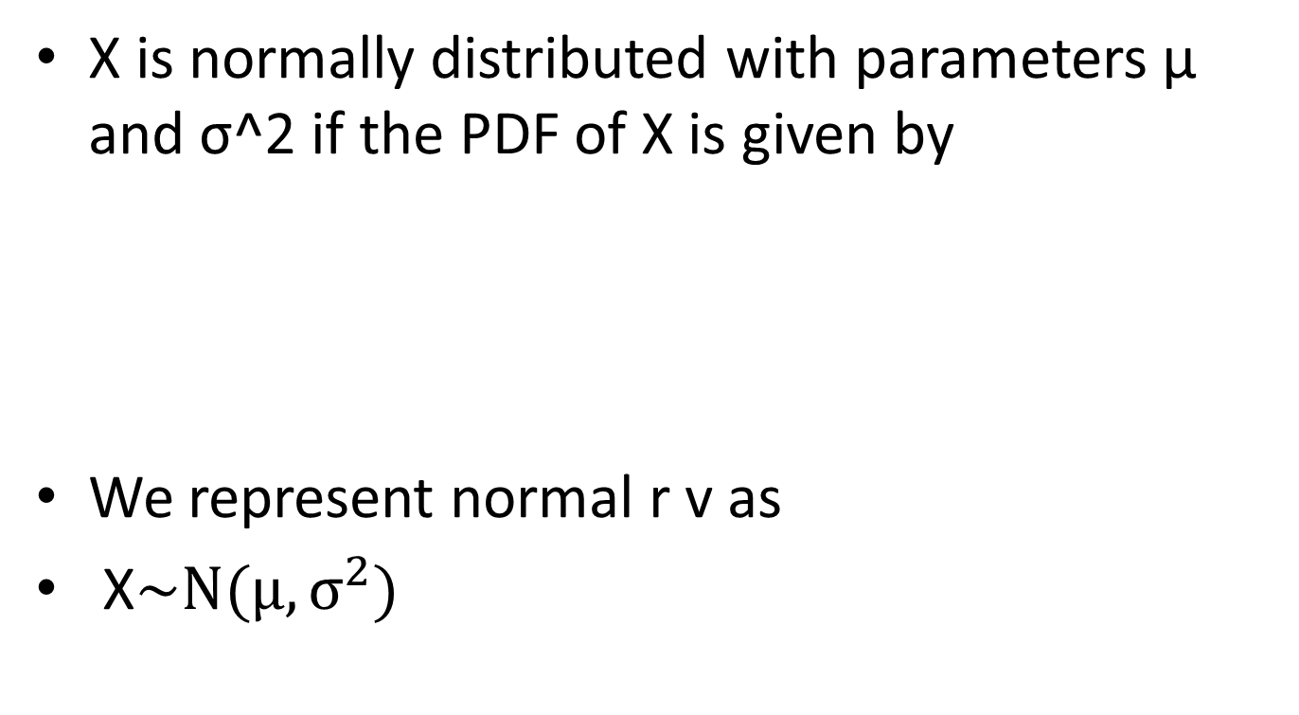
PDF of the normal distribution
X is normally distributed with parameters µ and σ^2 if the PDF of X is given by
We represent normal r v as
X$\sim N(μ,σ^{2})$

Slide 30
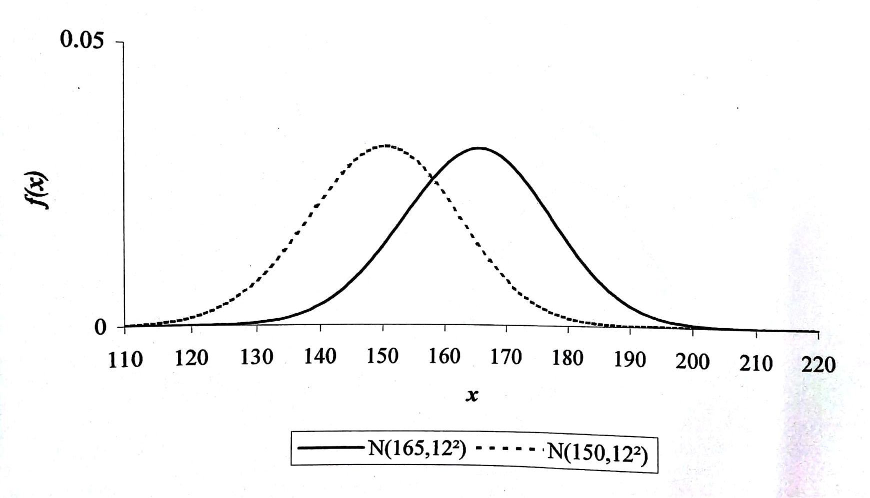

Slide 31
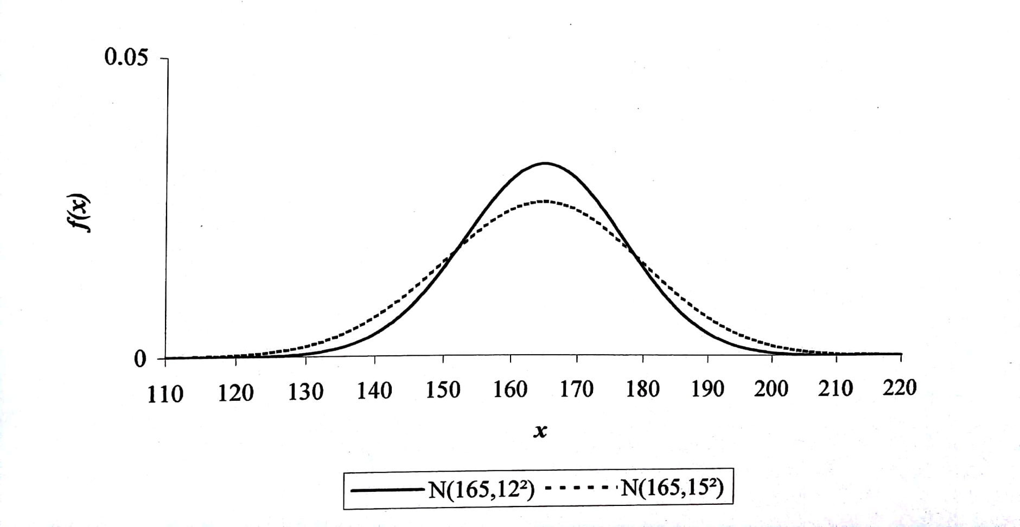

Slide 32
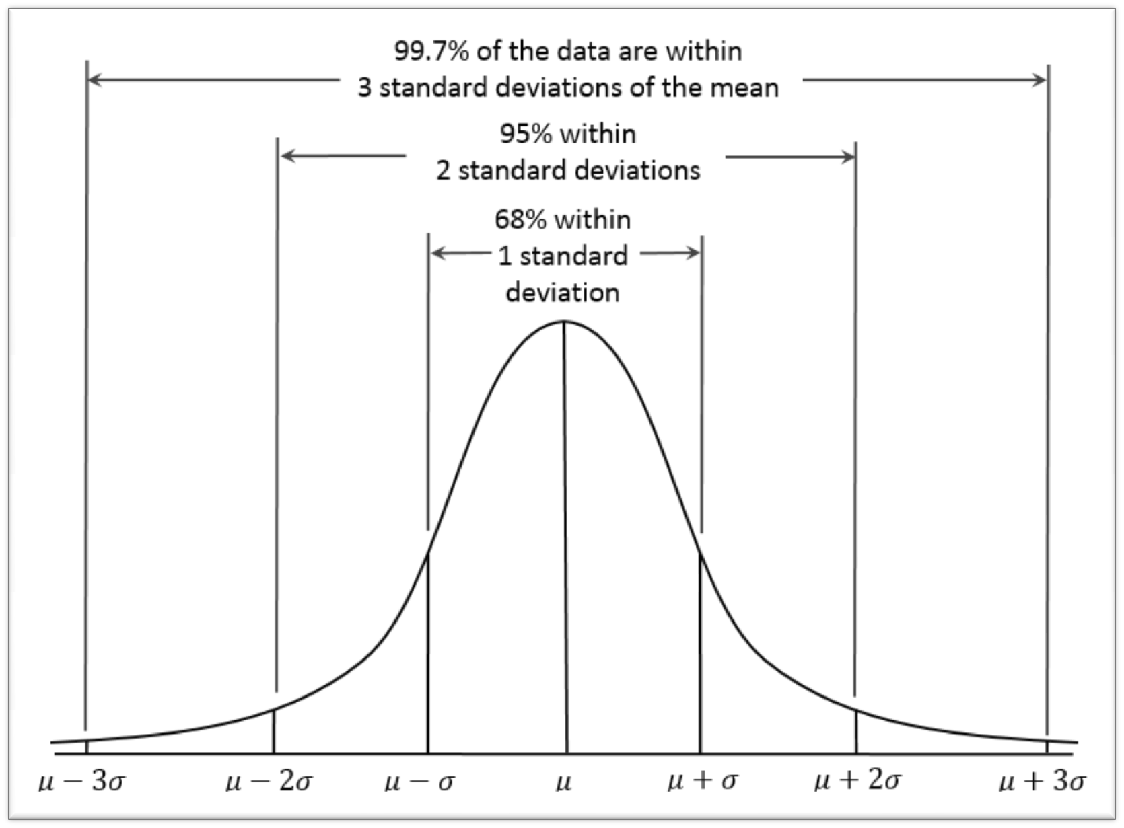

Slide 33
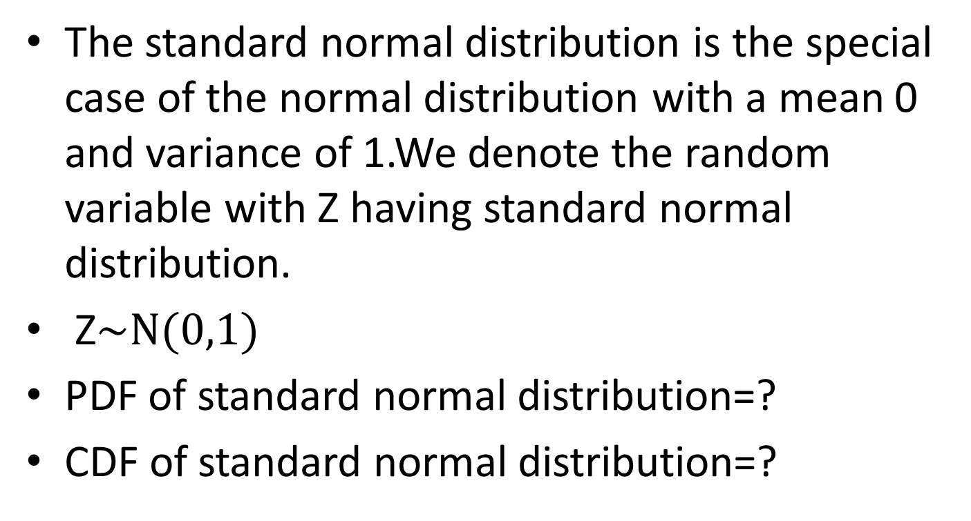
The Standard Normal Distribution
The standard normal distribution is the special case of the normal distribution with a mean 0 and variance of 1.We denote the random variable with Z having standard normal distribution.
Z$\sim N(0,1)$
PDF of standard normal distribution=?
CDF of standard normal distribution=?

Slide 34
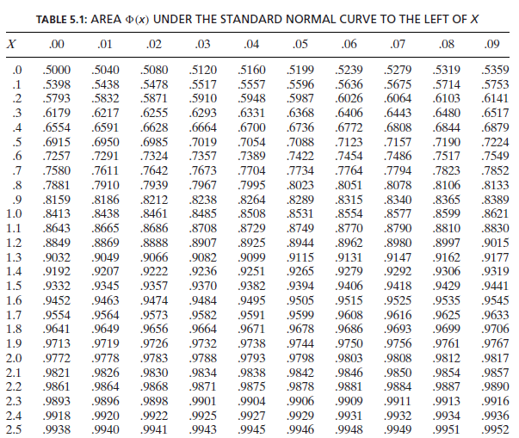

Slide 35
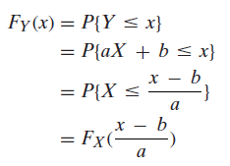
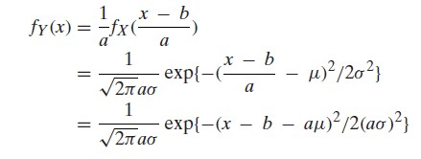
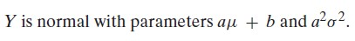

Slide 36
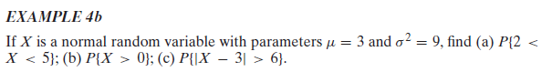
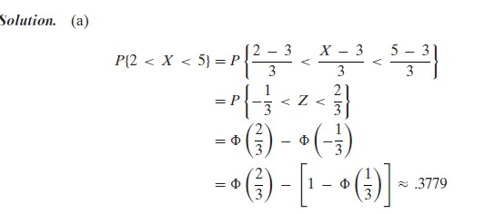
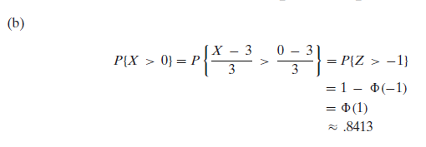

Slide 37
Probabilities involving interpolation
P(Z<0.426)=?
P(-0.704<Z<0.897)=?
The height of the Boy students are normally distributed with mean 178cm and variance 250cm^2.calculate the probability that a randomly selected boy student has height
(a) less than 186cm
(b)between 150 and 190 cms)

Slide 38
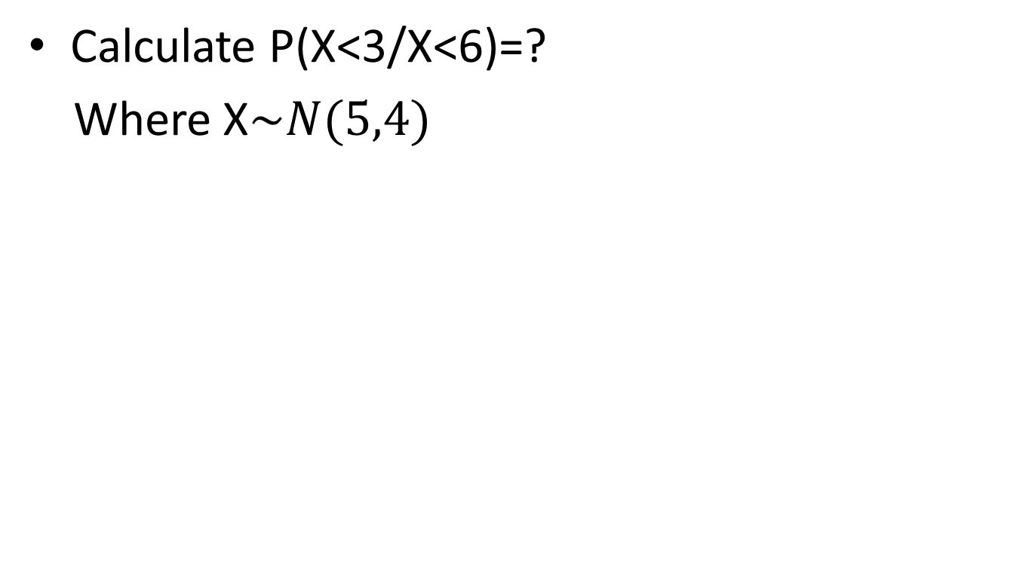
Problems on conditional probabilities
Calculate P(X<3/X<6)=?
Where X$\sim N(5,4)$

Slide 39
Markov Inequality

Slide 40
Chebyshev’s Inequality

Slide 41
Example
Suppose that it is known that the number of items produced in a factory during a week is a random variable with mean 50
(a)What can be said about the probability that this week’s production will exceed 75?
(b)If the variance of a week’s production is known to equal 25,then what can be said about the probability that this week’s production will be between 40 and 60?

Slide 42
The Central Limit Theorem
The central limit theorem is one of the most remarkable results in probability theory.
It provides basis for large sample inference about a population mean when the population distribution is unknown.
The central limit theorem states that the sum of large number of independent random variables has a distribution that is approximately normal.
The central limit theorem can also be used to give approximations to other distributions. This is useful if we are calculating the probabilities that would take too long.

Slide 43
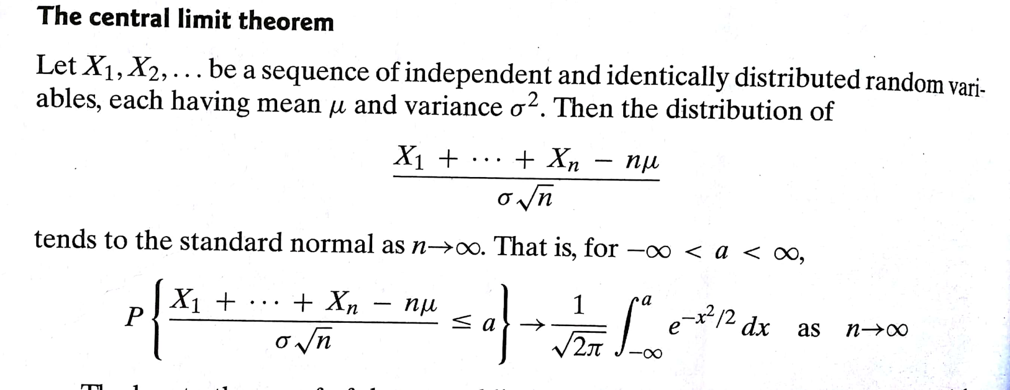

Slide 44
Example
It is assumed that the number of claims arriving at an insurance company per working day has a mean 40 and standard deviation of 12.A survey was conducted over 50 working days. calculate the probability that the sample mean number of claims arriving per working day was less than 35.

Slide 45
Normal Approximations
Binomial distribution
Poisson's distribution

Slide 46
Example
The average number of calls received per hour by an insurance company’s switchboard is 5.Calculate the probability that in a working day of 8 hours, the number of telephone calls received will be
(i) exactly 36
(ii) between 42 and 45 inclusive

